Slide 1
SQL Queries
Dog Groomers Database with Multi-table SQL Queries
For each of the following scenarios, paste in a screenshot of the SQL statement and the resulting data.

Slide 2
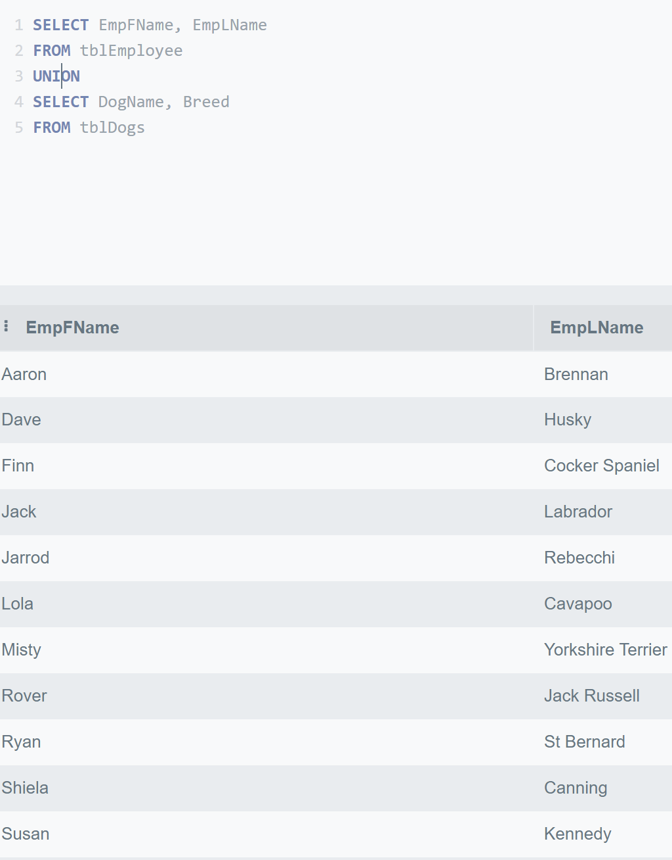
Return dog names, breed and the employee who works with them
SELECT EmpFName, EmpLName
FROM tblEmployee
UNION
SELECT DogName, Breed
FROM tblDogs

Slide 3
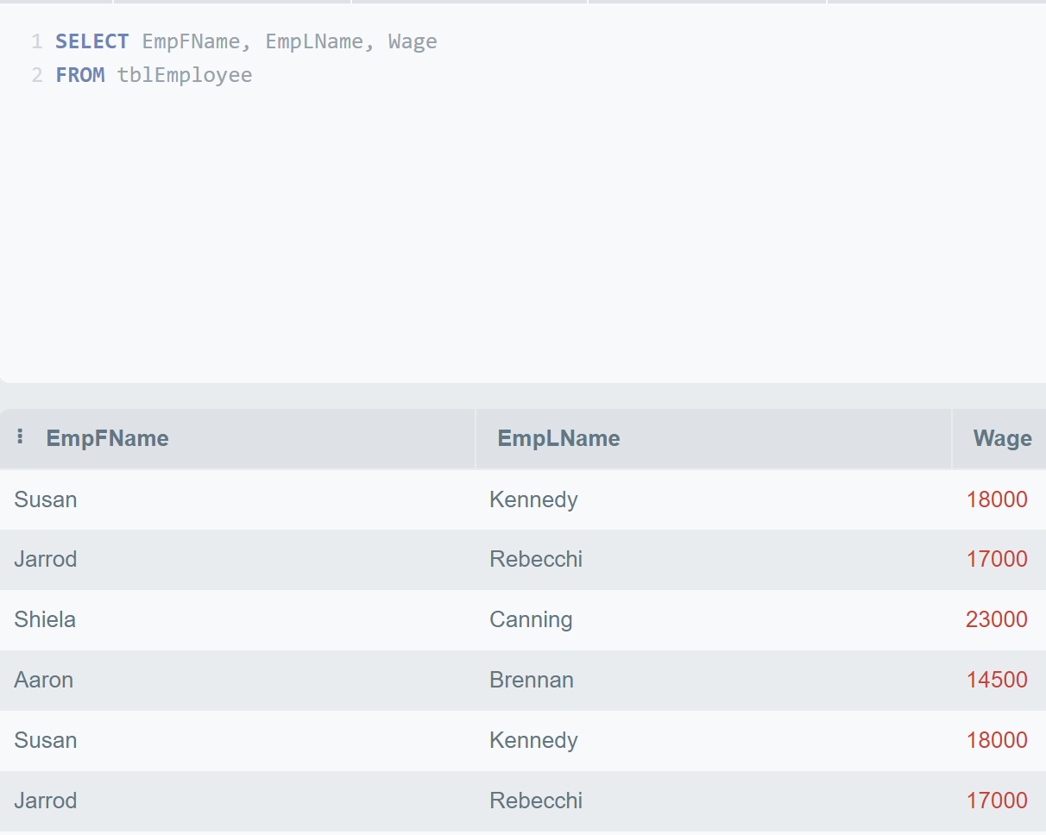
Display all employees with their salary

Slide 4
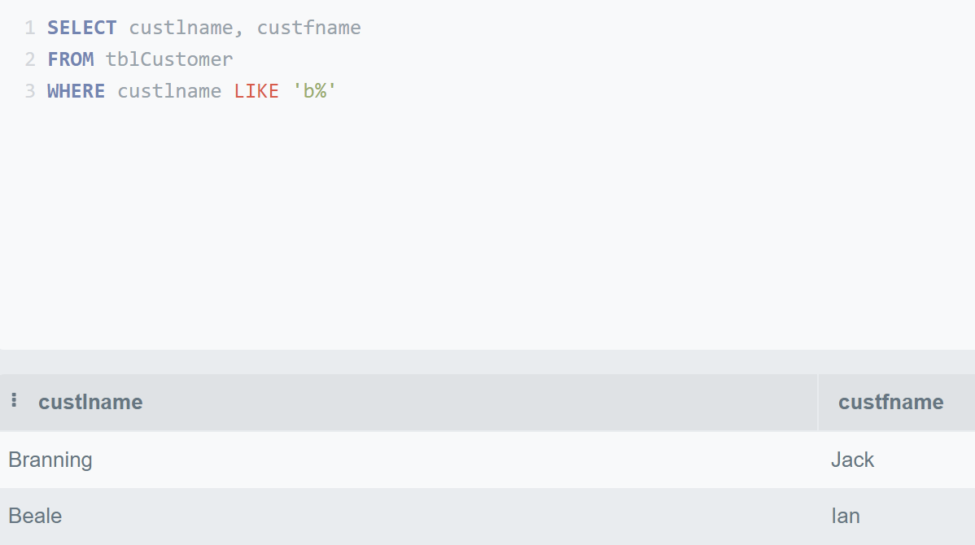
Display all customers whose last name begins with B

Slide 5
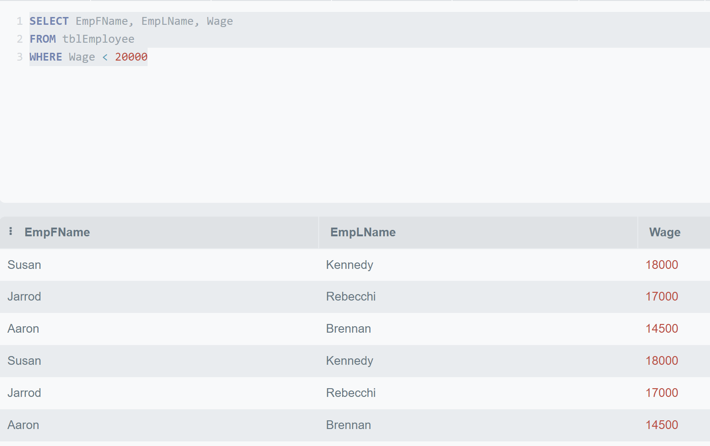
Display all employees who earn less than £20,000
SELECT EmpFName, EmpLName, Wage
FROM tblEmployee
WHERE Wage < 20000

Slide 6
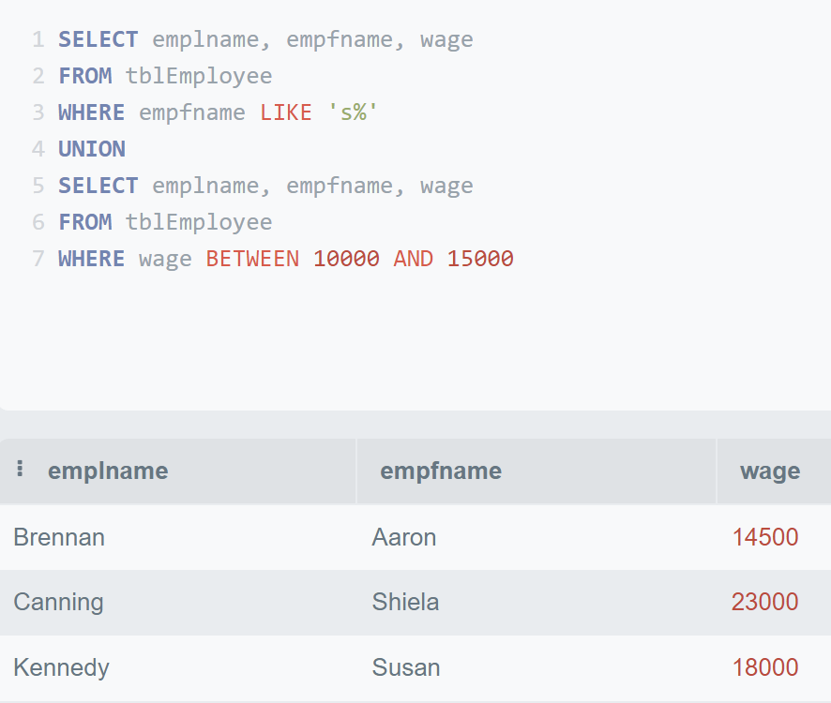
Display all employees whose first name begins with ‘S’ and all employees who earn between £10,000 and £15,000
SELECT emplname, empfname, wage
FROM tblEmployee
WHERE empfname LIKE 's%'
UNION
SELECT emplname, empfname, wage
FROM tblEmployee
WHERE wage BETWEEN 10000 AND 15000

Slide 7
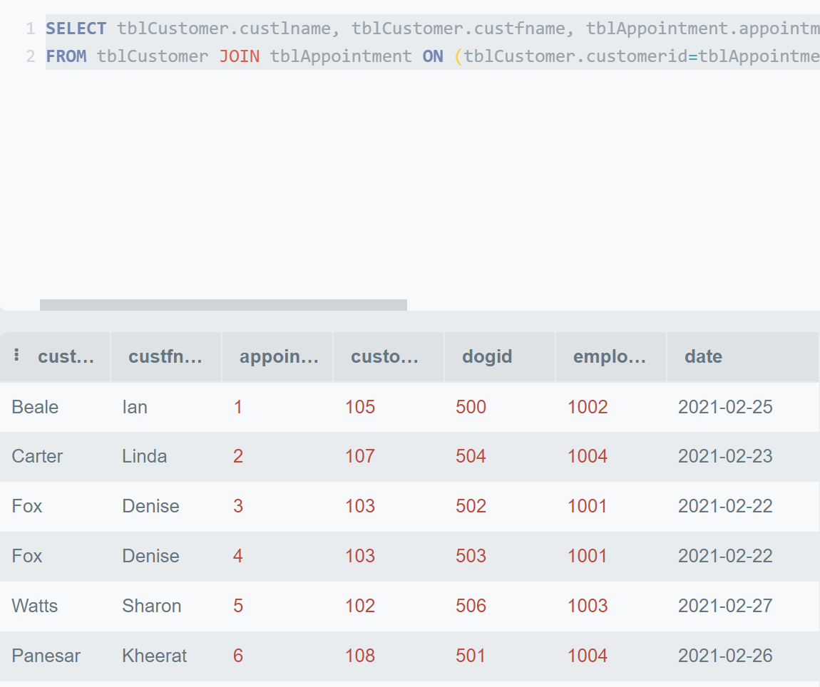
Display all Customers with their appointments
SELECT tblCustomer.custlname, tblCustomer.custfname, tblAppointment.appointmentid, tblAppointment.customerid, tblAppointment.dogid, tblAppointment.employeeid, tblAppointment.date
FROM tblCustomer JOIN tblAppointment ON (tblCustomer.customerid=tblAppointment.customerid)

Slide 8
Display all Customers with their appointments (in another way)
SELECT tblCustomer.custlname, tblCustomer.custfname, tblAppointment.appointmentid, tblAppointment.customerid, tblAppointment.dogid, tblAppointment.employeeid, tblAppointment.date
FROM tblCustomer JOIN tblAppointment ON (tblCustomer.customerid=tblAppointment.customerid)

